Slide 1
Ethical Leadership in Times of Change and Uncertainty

Slide 2
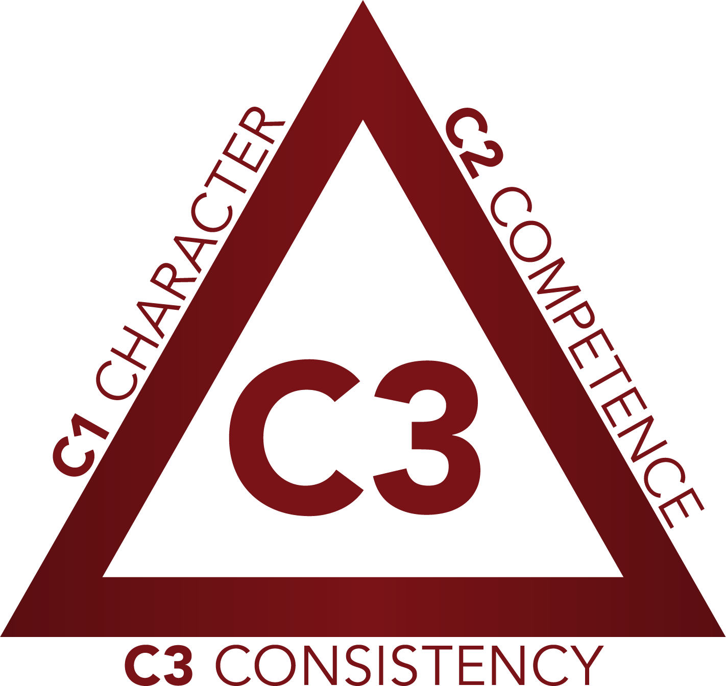

Slide 3
Ethical leadership is intentional leadership.

Slide 4
Ethical leadership is intentional leadership.

Slide 5
At the heart of ethical leadership is a genuine concern for people.

Slide 6
The ethical norms of an organization are determined by the actions of its leaders.

Slide 7
Ethical organizations effectively communicate their ethical code and integrate it into all aspects of organizational life.

Slide 8
Ethical Leadership and Change
Increased job satisfaction.
Enhanced performance.
Greater organizational citizenship.
Better performance in times of change when leaders are seen as fair and trustworthy.
Sharif, M. M., & Scandura, T. A. (2014). Do perceptions of ethical conduct matter during organizational change? Ethical leadership and employee involvement. Journal of Business Ethics, 124(2), 185-196.

Slide 10
Ethical Leadership in Times of Change and Uncertainty

